Slide 1

Area under the curve
By
Patrick macharia
Kmtc nairobi

Slide 2
Demonstrate understanding of pharmacokinetics
Use Cockcroft-gault formula in dosage calculation

Slide 3
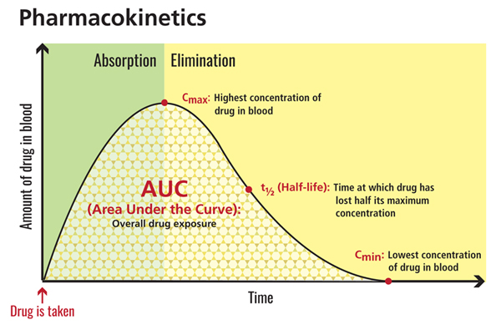

Slide 4
definition
-A measure of how much drug reaches a person's bloodstream in a given period of time after a dose is given.
-area under the curve is the definite integral of a curve that describes the variation of a drug concentration in blood plasma as a function of time.
-drug concentration is measured at certain discrete points in time and the trapezoidal rule is used to estimate AUC

Slide 5
carboplatin
For carboplatin have been noted that toxicities correlate better with area under the curve than body surface area
This estimates how much drug is exposed to the body based on kidney function

Slide 6
formula
Dose = AUC (GFR+25)
AUC= targeted area under the curve
Determined by oncologist based therapeutic index
Usually 2,5,6 a UAC of 7 gives patient more side effects and rarely will you see it been used
GFR= glomerular filtration rate
Estimates kidney functions
commonest formula –modified Cockcroft-gault
maximum GFR used in AUC is 125

Slide 7
GFR and CREATININE CREARANCE
MEN-[(140-age)wt in kg]/(72Xscr) X1
Women-[(140-age)wt in kg]/(72Xscr) X0.8
There are applications for calculation find out the one you are comfortable with
note adjustments in Cockcroft formula:
When pts wt is more than 125% of the expected (ideal body wt) use the adjusted wt instead
In elderly (>65yrs) and serum creatinine is less than 0.8..you will adopt 0.8 as Scr

Slide 8
Ideal body weight
Men =50+0.91(ht =152.4cm
Women = 45.5 +0.91 (ht -152.4cm)
this is the matrix system
If pt < 152.4cm tall
Mayconsider subtracting rather than adding

Slide 9
Adjusted body weight
= [(actual body weight-IBW)X0.4]+IBW

Slide 10
MAX possible dose depending on targeted AUC
MAX DOSE = | AUCx150
MAX GFR = | 125
AUC | MAX DOSE
2 | 300
4 | 600
5 | 750
6 | 900

Slide 11
Note
There are medical calculators that help clinician calculate the carboplatin dose required.

Slide 12


