Slide 1
Biochemistry lesson
Presenter: F. Waweru Date: 10/11/2020

Slide 2
CLASSIFICATION OF PROTEIN
Classification by function
Catalytic proteins which catalyze biochemical reactions and are called enzymes.
Transport proteins which circulate, bind and transport other molecules in the cells and in the blood e.g. hemoglobin.
Regulatory proteins, which are chemical messengers that help regulate physiological processes e.g. hormones.
Defense proteins, which protect the body disease e.g. immunoglobins.
Storage proteins which contain nutrients for an organism e.g. ferritin and casein.
Structural proteins which provide mechanical support especially in bones, skin hair etc.

Slide 3
Classification of proteins cont’d…
Classification by shape into two:
Fibrous protein, which are water insoluble and are mainly found in the hair, skin connective and elastic tissue.
They are string like and can intertwine to form strong fibers.
Globular protein, are water soluble and forms stable suspensions.
These include enzymes, blood proteins and immunoglobins

Slide 4
Protein classification cont’d
Classification by Composition
Proteins can be simplified as either:
Simple protein which is made up of only amino acids residues.
Conjugated protein which has other chemical components in addition to amino acids incorporated in it.
These may be organic or inorganic prosthetic groups (heme units, lipid molecule, carbohydrate or metal ion:
Examples of conjugated proteins are
  Gycoproteins
  Lipopreins

Slide 5
Dietary Protein Quality
The nutritional quality of dietary protein is generally determined by three factors:
Essential amino acid composition,
Digestibility
Amino acid requirements of the species consuming the protein.
Essential amino acid composition,
The specific amino acid that is in shortest supply is called the limiting amino acid. Protein quality is defined according to the amino acid pattern of egg protein as a reference.
Animal proteins: are often classified as being "complete" because they contain all the nine indispensable amino acids in concentrations sufficient to meet effectively the requirements of humans.
Most plant proteins: are classified as "incomplete" as they are deficient in one or more of the indispensable amino acids. Grains are generally deficient in lysine while pulses (legumes) are short of methionine

Slide 6
Protein quality cont’d…
Digestibility
Before a protein can serve as a nutritional source of amino acids, it must be digested. Any factor that alters digestibility would in turn affect the nutritional value of a protein.
Digestibility and utilization of legume protein is limited by the structure of the protein and the presence of antimetabolic/ antinutrient factors such as protease enzymes inhibitors, phytates and polyphenols.
In many raw food ingredients, proteins may not be hydrolyzed by digestive enzymes because of the presence of protease inhibitors such as trypsin inhibitor in raw soybeans.

Slide 7
Protein quality cont’d….
Essential amino acid requirements
infants and growing children have a higher requirement for essential amino acids compared to the adults.
Amino acid requirements is also determined by the type of species consuming the protein.
For example , a young lab rat needs more arginine than humans even though the requirements in the species diminishes as the animals grow old.

Slide 8
AMINO ACID CATABOLISM
Two main reactions in amino acid catabolism are
transamination
oxidative deamination.
Transamination-the transfer of an amino group from one molecule to another, especially from an amino acid to a keto acid.
Transamination (or transfer of amino group) is a chemical reaction through which amino acids transfer their amino group to an alpha-keto acid forming new amino acids.
The enzymes involved in transamination are known as transaminases/ aminotransferases

Slide 9
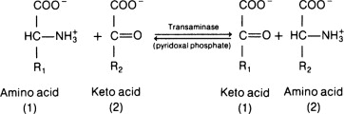
Transamination diagram

Slide 10
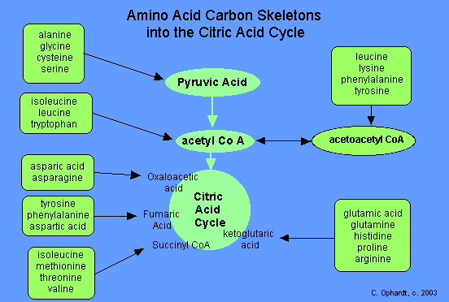
Transamination cont’d…

Slide 11
Oxidative deamination
Oxidative deamination
Involves the oxidative removal of the amino group from glutamate by the enzyme glutamate dehydrogenase
This reaction regenerates α-ketoglutarate and the second product is ammonium ion (NH₄⁺).
The reaction requires NAD⁺ or NADP⁺ as oxidizing agents and it regenerates α-ketoglutarate for additional transamination reactions.
The ammonium ion is then converted to urea and excreted through the urea cycle.
During oxidative deamination, an amino acid is converted into the corresponding keto acid by the removal of the amine functional group as ammonia and the amine functional group is replaced by the ketone group. The ammonia eventually goes into the urea cycle.
Oxidative deamination occurs primarily on glutamic acid because glutamic acid was the end product of many transamination reactions

Slide 12
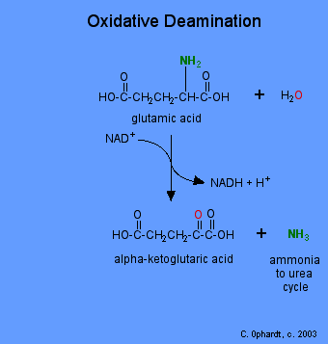
Oxidative Deamination

Slide 13
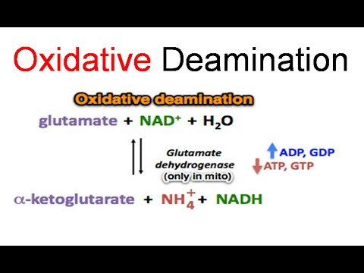
Oxidative deamination cont’d

Slide 14
Glucose Alanine Cycle
Used as a mechanism for skeletal muscles to eliminate nitrogen and to replenish energy supply
The major function of the glucose-alanine cycle is to allow non-hepatic tissues to deliver the amino portion of catabolized amino acids to the liver for excretion as urea
Amino acids are used as fuel in muscle and amino groups collected as glutamate by transamination reaction
In the muscle, glutamate transfers its amino group to pyruvate to form alanine

Slide 15
Glucose alanine cycle cont’d…
Alanine is transported through the blood to the liver where it is undergoes transamination by αketoglutarate to pyruvate.
Alanine is the form in which amino groups are transported to the liver in non-toxic
Pyruvate is converted to glucose (through gluconeogenesis) in the liver and the glucose is transported back to the muscle for energy.
Glutamate releases ammonia for excretion through urea cycle

Slide 16
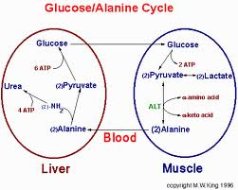
Glucose alanine cycle diagram

Slide 17
Urea cycle
The urea cycle is the metabolic pathway that transforms nitrogen to urea for excretion from the body.
Nitrogenous excretory products are removed from the body mainly in the urine.
Ammonia, which is very toxic in humans, is converted to urea, which is nontoxic, very soluble, and readily excreted by the kidneys.

Slide 18
Location of Urea Cycle
Cytosol and mitochondria of hepatocytes.
Substrates: NH₃ (as derived from oxidative deamination of glutamate); CO₂; aspartate; three ATP.
Products: Urea; fumarate; H₂O
Purpose
The urea cycle allows for the excretion of NH₄⁺ by transforming ammonia into urea, which is then excreted by the kidneys.

Slide 19
Urea cycle steps
1. Synthesis of carbamoyl phosphate by Carbamoyl Phosphate Synthetase Iin mitochondria of the liver
2. Synthesis of citrulline from carbamoyl phosphate and ornithine by Ornithine Transcarbamoylase
3. Synthesis of argininosuccinate by condensation of citrulline and aspartate by Argininosuccinate Synthetase driven by the cleavage of ATP; AMP and inorganic pyrophosphate produced; inorganic pyrophosphate cleaved by cellular pyrophosphatases to inorganic phosphate

Slide 20
Urea cycle steps cont’d
4. Argininosuccinate cleaved by Argininosuccinase to produce fumarate and arginine NOTE: cycle intermediate, and can be hydrated to form malate.
5. Urea production and the regeneration of ornithine from arginine by Arginase urea passes into the blood and is eliminated by the kidneys,
urea accounts for approx. 90% of all bodily nitrogenous excretory products.
ornithine is synthesized from glucose; arginine is synthesized from ornithine by the urea cyc

Slide 21
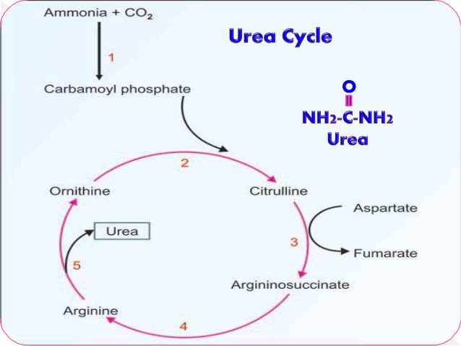

Slide 22
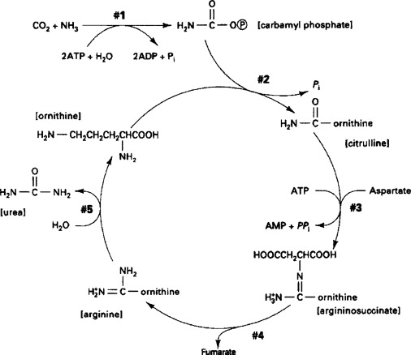

Slide 23
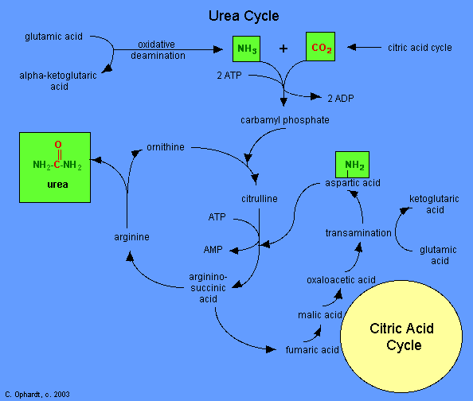

Slide 24
Important enzymes in Urea Cycle
Carbamoyl phosphate synthetase I: Converts ammonium and bicarbonate into carbamoyl phosphate. This is the rate-limiting step in the urea cycle. This reaction requires two ATP and occurs in the mitochondria.
Ornithine transcarbamoylase: Combines ornithine and carbamoyl phosphate to form citrulline. Located in mitochondria.
Argininosuccinate synthetase: Condenses citrulline with aspartate to form arginosuccinate. This reaction occurs in the cytosol and requires one ATP.
Argininosuccinate lyase: Splits arginine succinate into arginine and fumarate. Occurs in the cytosol.
Arginase: Cleaves arginine into one molecule of urea and ornithine in the cytosol. The ornithine is then transported back into the mitochondria for entry back into the cycle

Slide 25
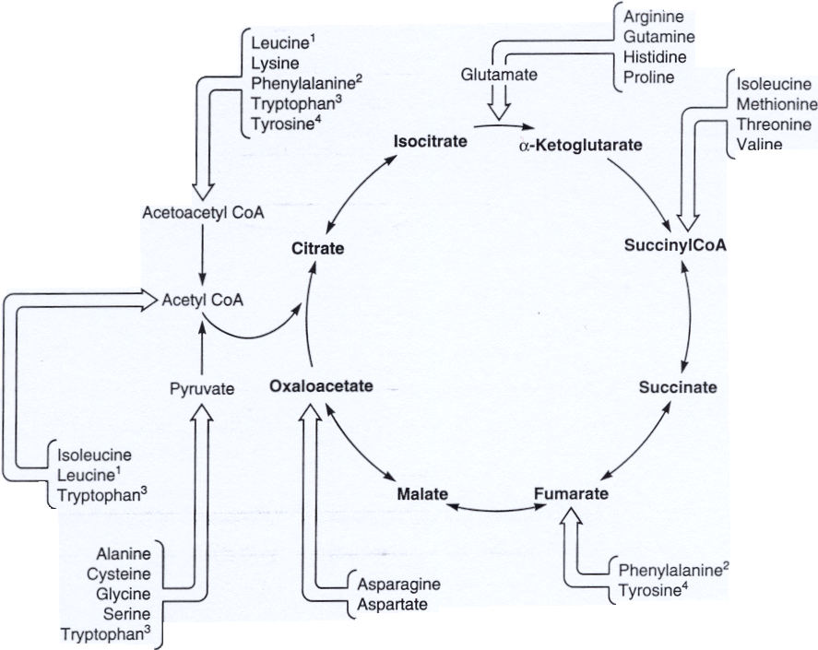
Summary of AA metabolism (Aerobic intermediates)

Slide 26
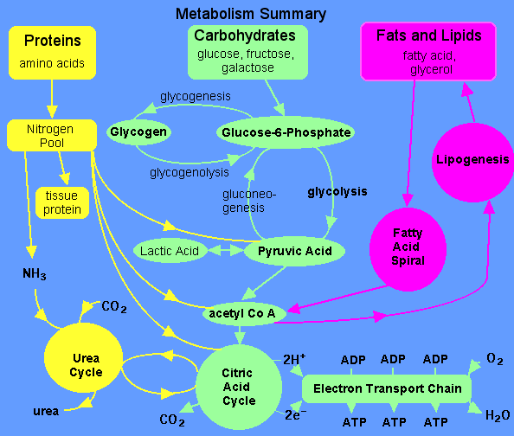
Summary of Metabolism

Slide 27
The End
Thank You

